Slide 1
Research Updates
15th September 2023

Slide 2
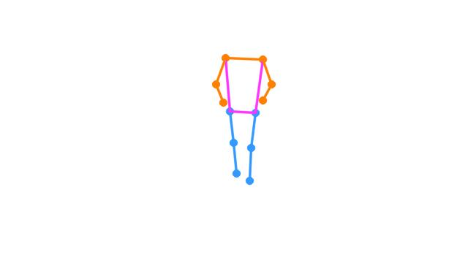
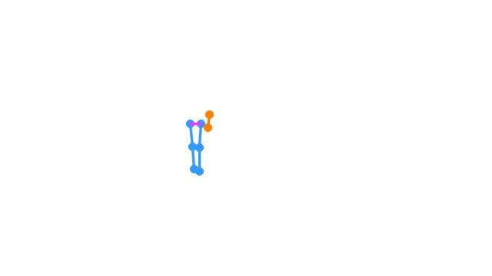
Skeleton Generation
A skeleton was generated used a YOLO v8 model
Along with skeletons, the models also generated a bounding box around objects in the image
It took around 0.4 seconds to process each image

Slide 3
Looking ahead
One of the problems of using the YOLO V8 model is the colored output it provides
We need to convert all the skeletons to a single color
All the frames in the dataset were the same size
This eliminates the need for normalization. All the skeletons are placed exactly where the patient was in the frame
Energy image generation
In Remote Gait Type Classification System Using Markerless 2D Video, the frames (separated by 10 frames) were segmented and averaged to obtain the energy image
Another method to obtain energy images is increase the opacity of the images and stack images on top of each other
Sub-classification
We can explore an algorithmic approach by using the data provided by YOLO V8 for video-wide classification
Otherwise, for multiple classifications per video, we will have to use a manual approach

Slide 4
To do
Divide the videos into forward and backward frames
Re-do the frame extracting using the appropriate sampling frequency
Re-extract the skeleton
Re-size the images using bounding boxes
Drop images with less than 12 keypoints
Create energy images
Transform into vector

